Slide 1
2013: The Year Music Got Weird
Joshua Ogden-Davis
January 2024
For Springboard

Slide 2
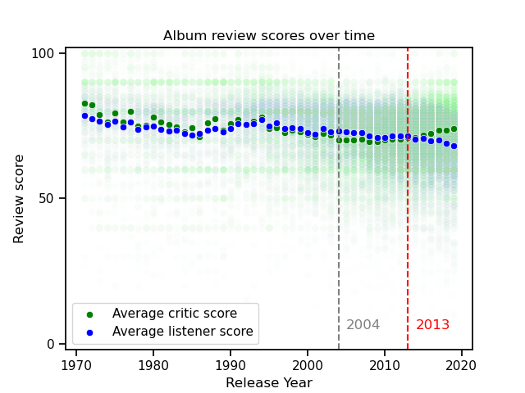
In 2013…
Critics and listeners began rating music differently, for the first time since we started collecting data.
Listener reviews followed the long, slow, downward trend, while critic scores began an upward trend.

Slide 3
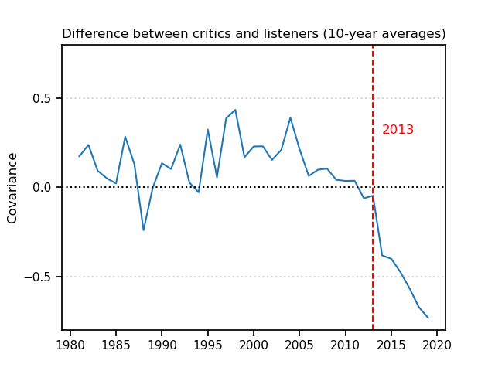
Is that a big difference?
It might look small on the previous graph, but it’s unprecedented!
This chart is a 10-year rolling average of the differences between listener and critic scores. It usually changes direction frequently, staying close to 0… until 2013, when it starts falling off the edge of the Earth!

Slide 4
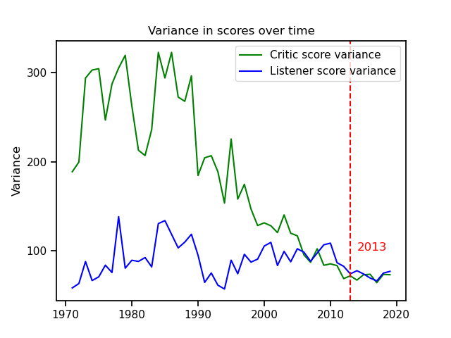
What else changed?
For one, critic scores used to have a lot more variance, but their variance reached a low point and synced up with listeners’ scores at about the same time.
Simply put, critics were rating music more consistently all of a sudden.

Slide 5
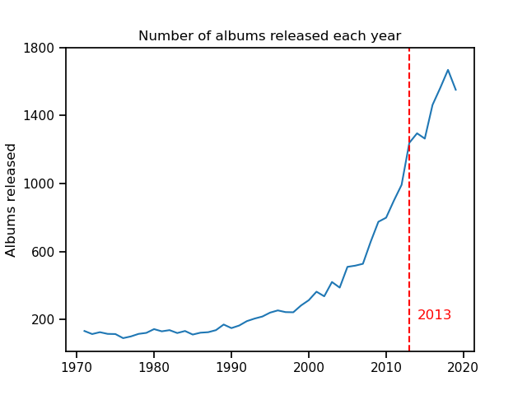
But did the music change?
Quite possibly.
For one, there’s been an explosion of the number of albums released each year since the 90s, and the rate suddenly blips right at 2013, but quickly recovers.
So, something definitely happened…

Slide 6
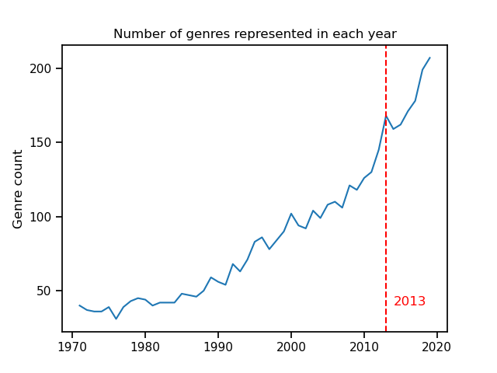
Whoa!
Indeed! And the number of different genres in the market also blipped at exactly that time.
So, whatever happened in 2013 changed:
1. Critic behavior
2. New album quantity
3. Musical variety
All at once!

Slide 7
But why?
After a long examination, I don’t believe the answer is in this dataset.
I think the most likely candidate is the growing popularity of music streaming services.
Spotify hit a few big milestones that year, and new services were introduced.
New modes of listening change monetary incentives for both musicians and critics.
It also changes listener behavior, as well as the music they’re exposed to.
But, one thing didn’t change…

Slide 8
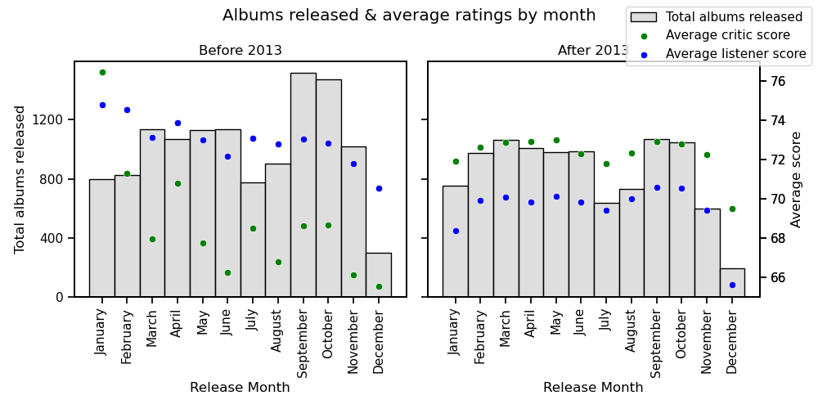
Nobody releases new music in December,
and everyone will hate it if you do!

Slide 9
Thank you
Joshua Ogden-Davis
January 2024
For Springboard

